Slide 1

World Expenditure Analysis Group 15
Contributers:
Anish Kumar, Atul Acharya, Harshit Bhadani, Sri Harsha Pamidi, Sumukh Badam

Slide 2
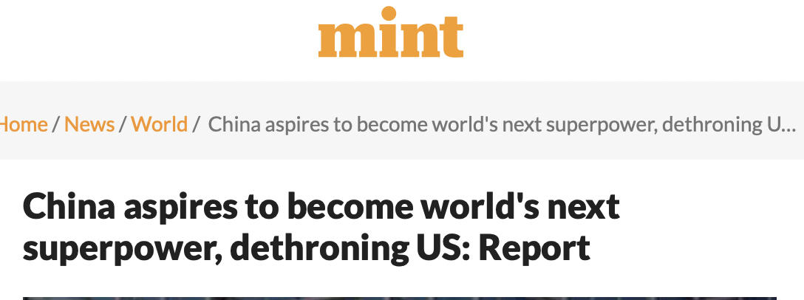
Motivation
Published in Mint on 09th, Sep 2021
What is China doing differently?
Can we take similar steps to improve our GDP growth?
Does Government Expenditure have a clue!?

Slide 3

Roadmap
Conclusion
EDA + Data Visualization
Data Extraction
Data Cleaning

Slide 4

Data Extraction
https://data.oecd.org
OECD* countries taken in consideration: United States, United Kingdom, France, Germany
https://data.worldbank.org
Non-OECD* countries taken for comparison: China
https://www.ceicdata.com/en/indicator/china/tax-revenue
*OECD: Organization for Economic Cooperation and Development

Slide 5
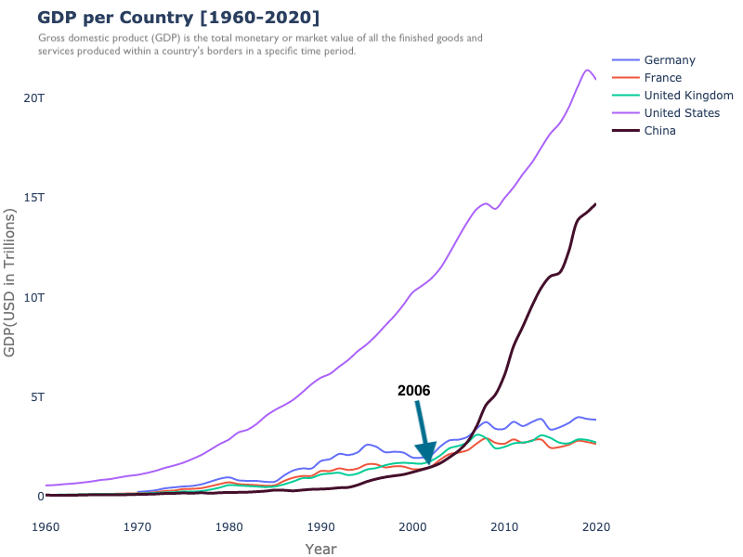
China’s progress
~10% of GDP growth per year
Highest among any nation in this period

Slide 6
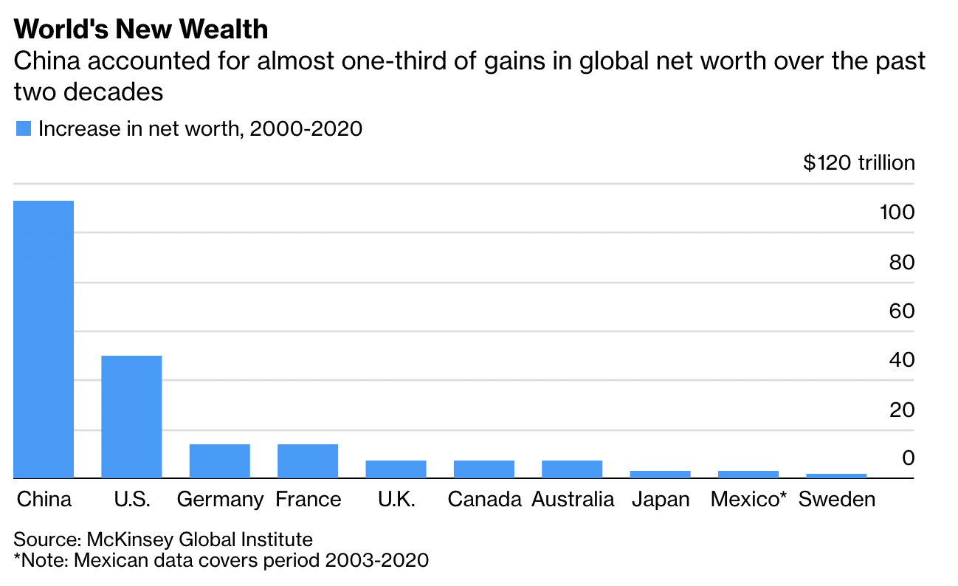
China’s Progress – contd.

Slide 7
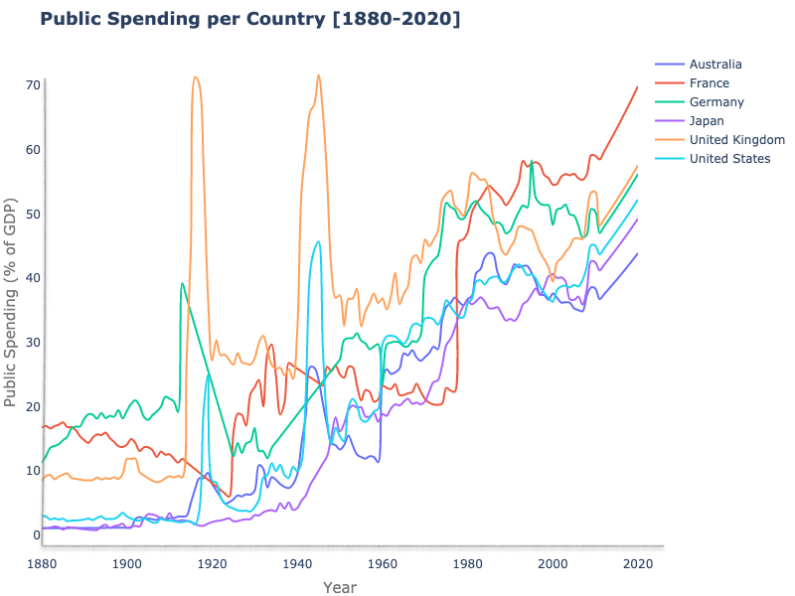
Historical data of Government spending
Growth has been the general trend since 1945
Volatile
(World War)
Low
spending
Government spending - money spent by the public sector on the acquisition of goods and provision of services such as education, healthcare, social protection and defense.

Slide 8
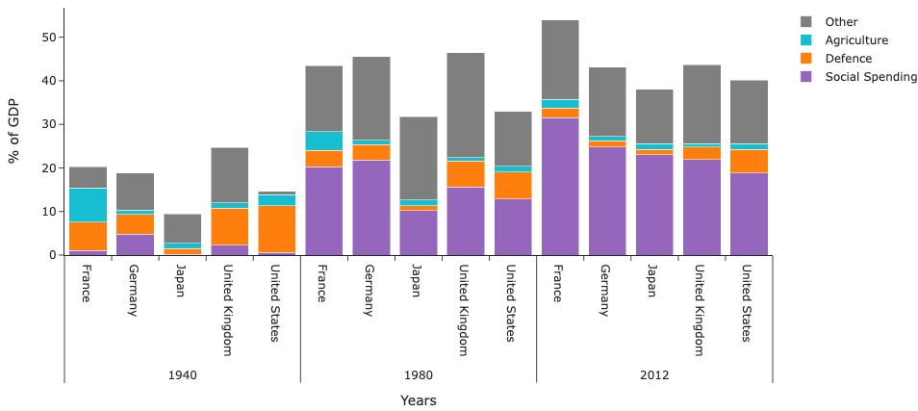
Government Spending per sector
Avg. Social Spending(% GDP) increased the most

Slide 9
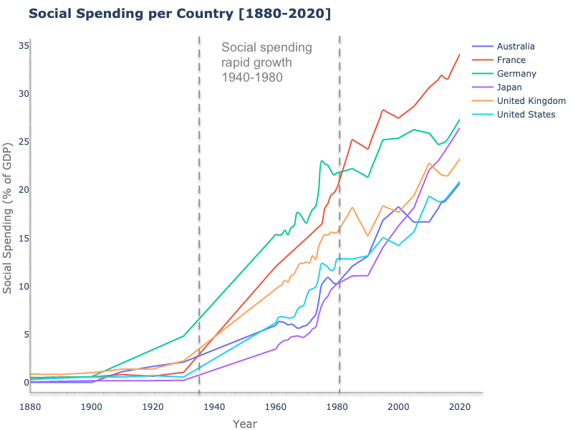
Social Spending
Social spending pays for programs that provide healthcare, income security, education, nutrition, housing, and cultural services.

Slide 10
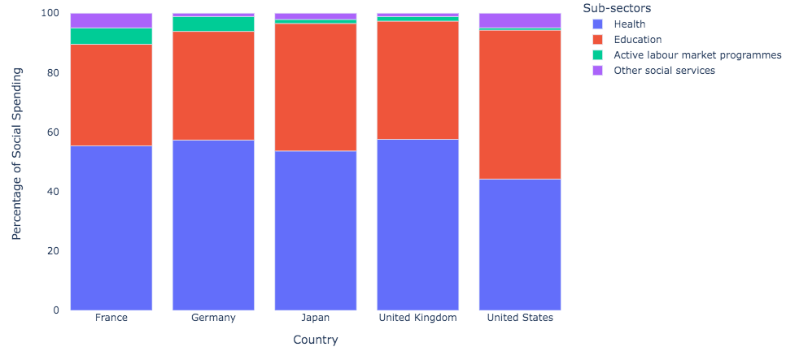
Social Spending : A closer look
The steep growth of social spending in the second half of the 20th century was largely driven by the expansion of public funding for healthcare and education.
Where did all this money come from?

Slide 11
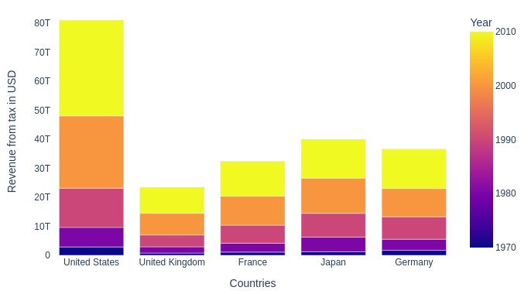
Taxation
Post World War II, tax revenues started growing considerably across all the countries.
Increases in taxation went together with more social spending.

Slide 12
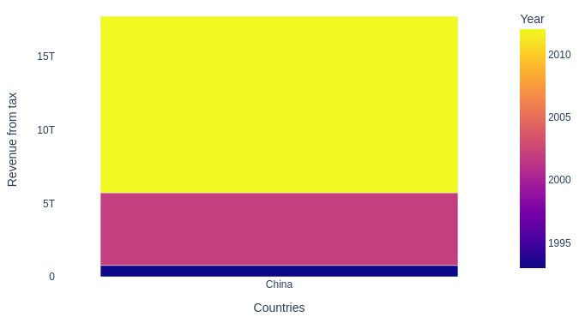
Tax Revenue for China [1990-2020]

Slide 13
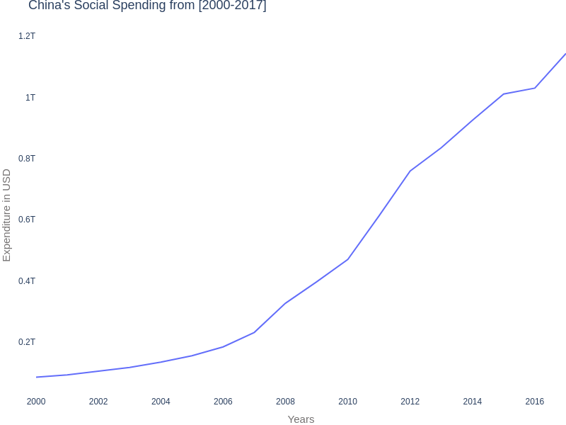
China’s Case
Shows a positive correlation between Social Spending and GDP growth rate.
Both Tax Revenues and Social Spending increased multifold post 2006.
Tax reforms and a well-structured tax collection system is important for a country’s growth.

Slide 14
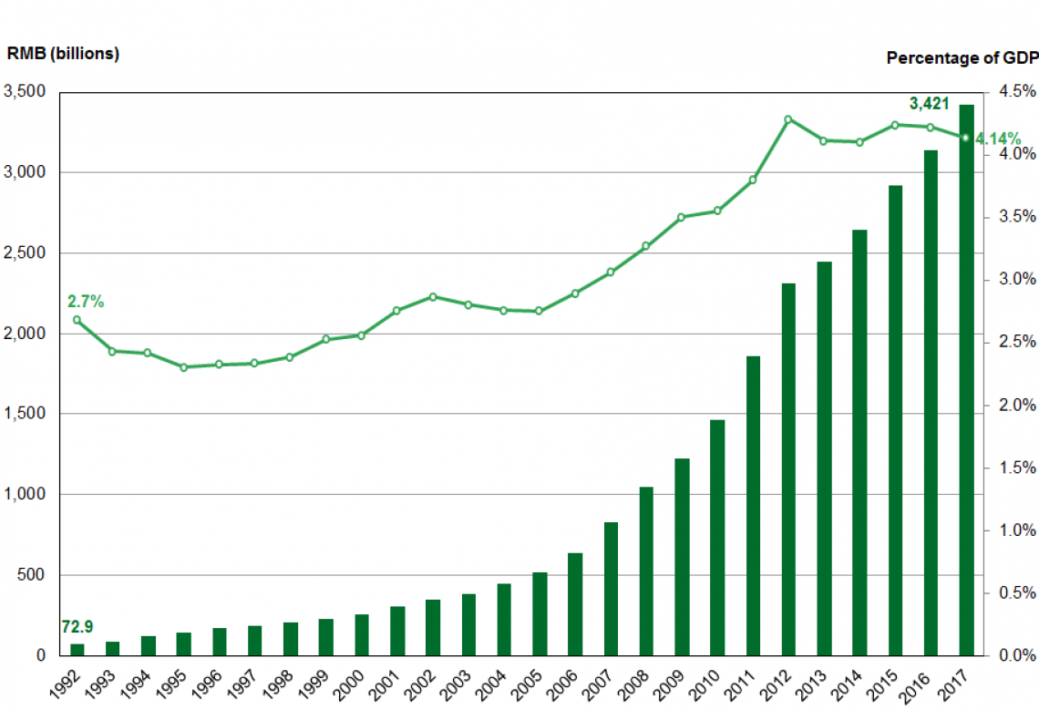
Social Spending on Education In china

Slide 15
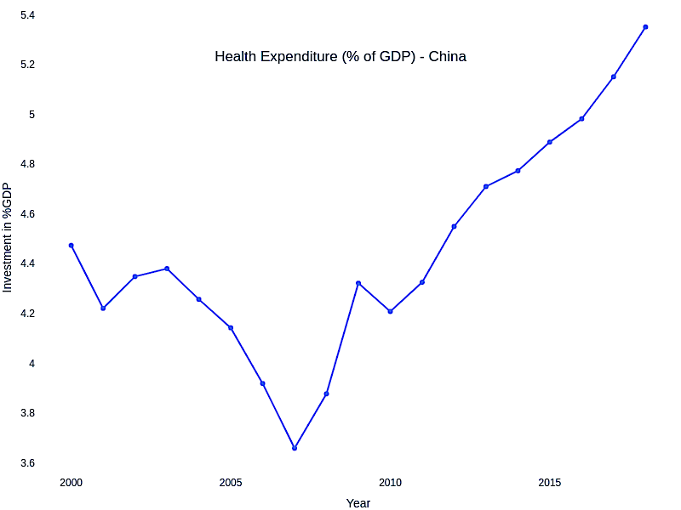
Social Spending on Healthcare

Slide 16
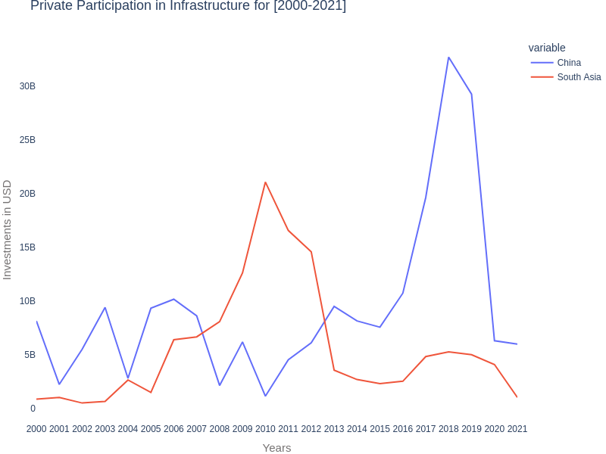
Upward Thrust! - Contribution of PPI*
*PPI – Private Participation in Infrastructure

Slide 17

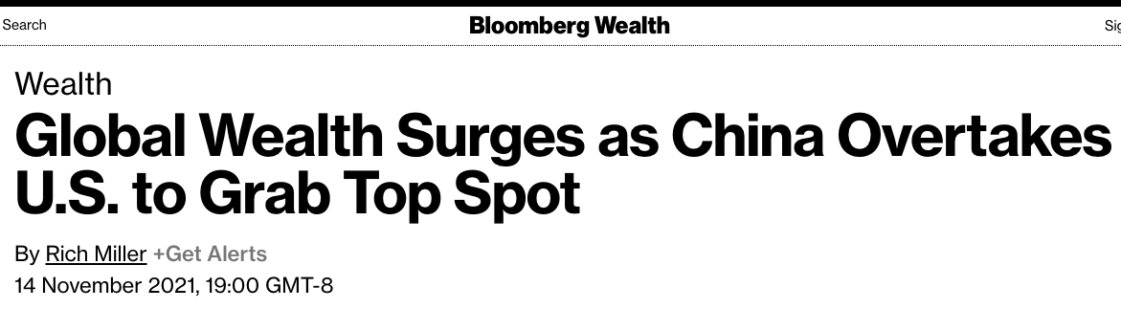
Conclusion
A well-structured tax collection system is important for a country’s growth.
Greater tax revenue can be better spent on social spending to drive country’s GDP growth.
Privatization might be the key to the next jump!

Slide 18
Further Scope and Improvements
The data analysis has been done by taking macro economic factors into consideration only. We can gain much more insight if we have data on micro economic factors as well.
We can use both macro and micro economic data to train a model which can guide other developing nations to grow as China did.

Slide 19
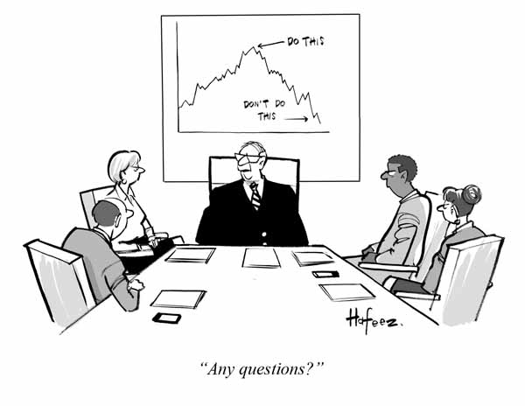

Thank you!

